Slide 1
Welcome to our Reading Workshop
Miss Hunter
Mrs Leyland

Slide 2


Slide 3




Reading at st. joseph’s
Questioner: Who… What… When… Where… Why… How… What if… Questions linked to the events, characters, theme, word meaning.
Clarifier: Check understanding… Check word meaning… Check phrase meaning… Check links and connections within the story… Actively engage with all parts of the text.
Summariser: The most important ideas are … The main idea is … This part was about … First, ….. Next, …. Then, … This story takes place in … The main characters are … The problem of the story is … Using own words to describe and discuss main ideas and themes.
Predictor: I think …. I’ll bet… I wonder if … I imagine … I suppose … I predict … I think this text will be about… Using evidence in the text or illustrations, make predictions.
Roles we take when we read.

Slide 4
Reading at St joseph’s

Slide 5

Children are made readers in the laps of their parents
A stronger relationship
Academic excellence overall
Speech skills
Communication skills
Uncovering new language
Logical thinking and abstract ideas
The knowledge that reading is fun!

Slide 6



Ric
Picking out the answer
Making inferences based on what you’ve read or seen – “reading in between the lines.”
Stepping into the author/creators shoes to consider why they made a certain choice

Slide 7
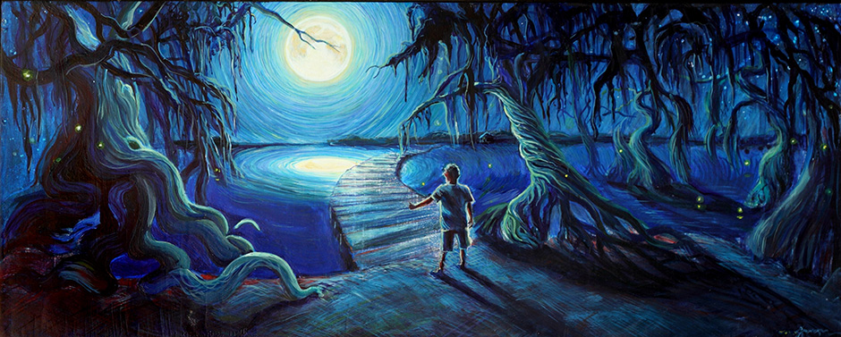
RIC - Developing comprehension skills

Slide 8
RIC - Developing comprehension skills
Retrieve:
What colour is the moon?

Slide 9
RIC - Developing comprehension skills
Retrieve:
What colour is the moon?
Interpret:
What season could it be?

Slide 10
RIC - Developing comprehension skills
Retrieve:
What colour is the moon?
Interpret:
What season could it be?
Choice:
Why has the artist mainly used dark colours?

Slide 11

Ric
Practising the thinking skills needed for comprehension using a range of stimuli… pictures, videos, adverts, books covers, songs...
Home Help:
We encourage this sort of dialogue at home too, during day-to-day activities.

Slide 12
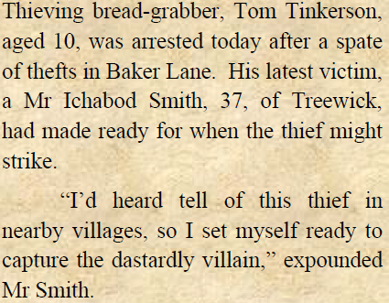
Understanding words
Demand for children to understand word meaning: “find and copy” type questions.
Word books – encourage a love of words and finding out meanings. It then filters into their vocabulary and their writing.
Dictionaries and Thesaurus skills
Also, developing strategies for finding out meaning when dictionaries aren’t available…
Home Help:
Look up the meaning of unknown words and record in Reading Record.

Slide 13
Understanding words
Read within the text a couple of times…
Is it a positive or negative word?
Do you know the meaning of other words around it?
Can you get an idea of what the words means even though you may not know exactly?
Home Help:
Encourage your child to use the strategies above when they are unsure of a words meaning.

Slide 14

Let’s have a go!

Slide 15
How do I get my child motivated to read?
Enthusiasm - going to choose books together from the Library, book shop or online.
- reading the blurb together and pointing out exciting/interesting parts.
Book suggestions - please find some recommended books on your handout.
Engaging discussion - point out parts that you’re enjoying.
Positive routine - comfy, quiet place, 1:1 time.
Interviews/films – is there an author interview or a film version of a children’s book?

Slide 16
authors
Year 3/4 | Year 5/6 | Authors like Anne Fine | Authors like Anthony Horowitz | Authors like JK Rowling
Nigel Hinton Berlie Doherty Francesca Simon Roald Dahl Gillian Cross Clive King Dick King Smith Jill Murphy Philippa Pearce Cressida Cowell Ted Hughes Emily Gravett Jenny Nimmo | Berlie Doherty Michael Morpurgo Shaun Tan RJ Palacio Philip Pullman Eva Ibbotson Frank Cottrell Boyce Louis Sacher CS Lewis David Almond David Walliams Philip Ridley Grace Nichols | Geraldine McCaughrean Jacqueline Wilson Dick King Smith Cathy Cassidy Sarah Singleton Adele Geras Malorie Blackman Michael Morpurgo | Charlie Higson Robert Muchamore Eleanor Up dale Philip Reeve Joe Craig Marcus Sedgewick | Jill Murphy Eva Ibbotson Diane Wynne Jones Darren Shan Ursula K Le Guin Jenny Nimmo Duncan Pile Nigel Hinton

Slide 17
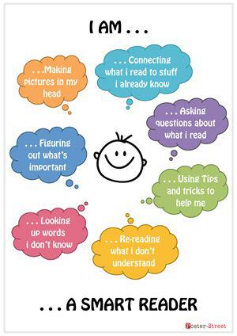

Slide 18

So what is the secret?

